Slide 1
SVD-clustering
Week 4

Slide 2
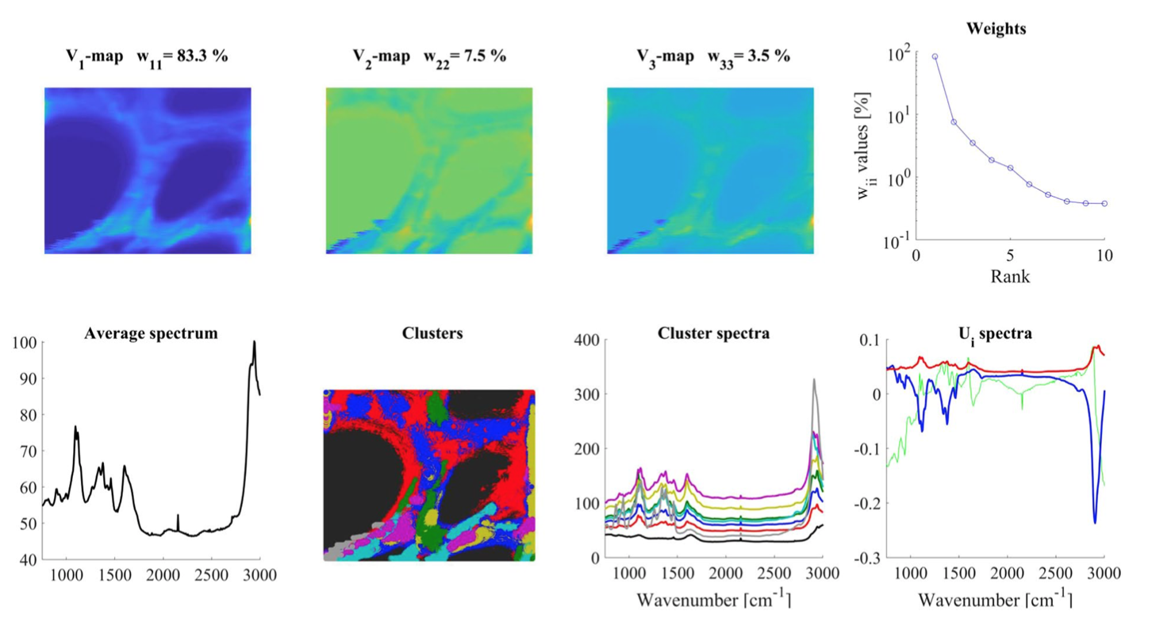
Their results

Slide 3
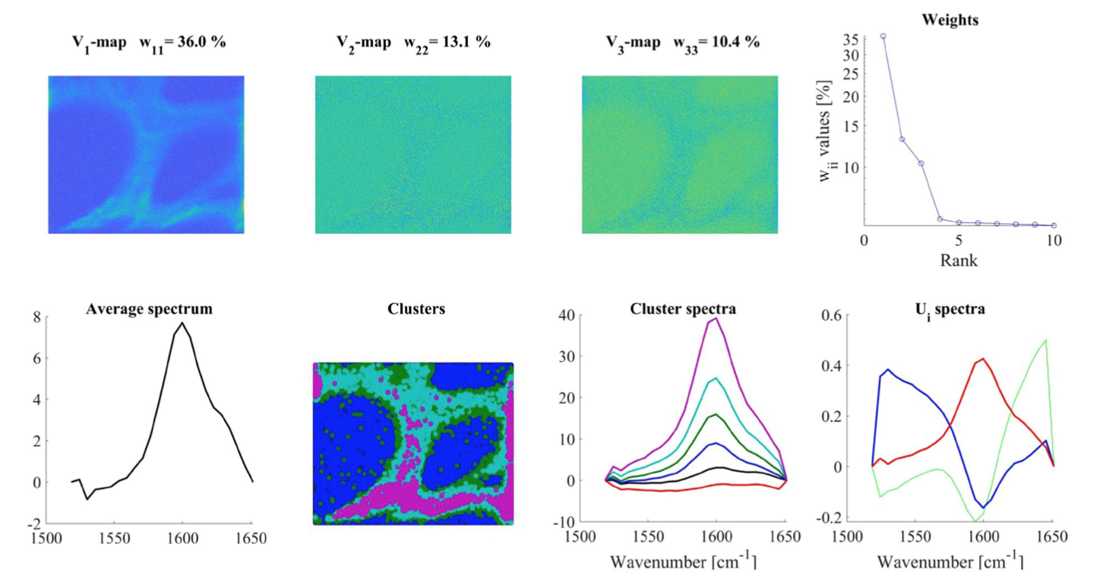

Slide 4
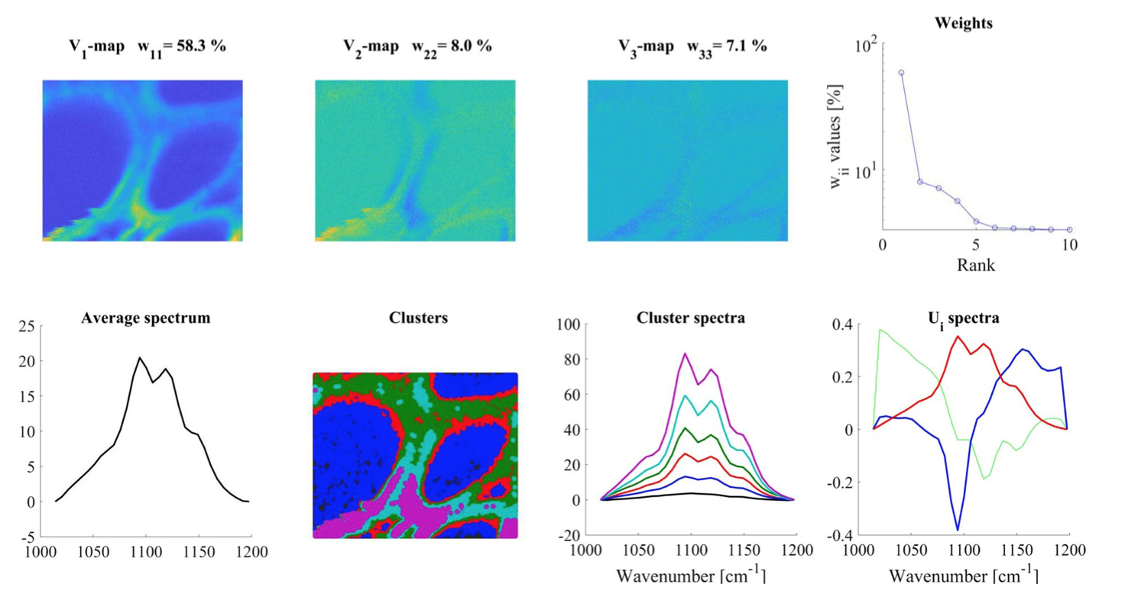

Slide 5
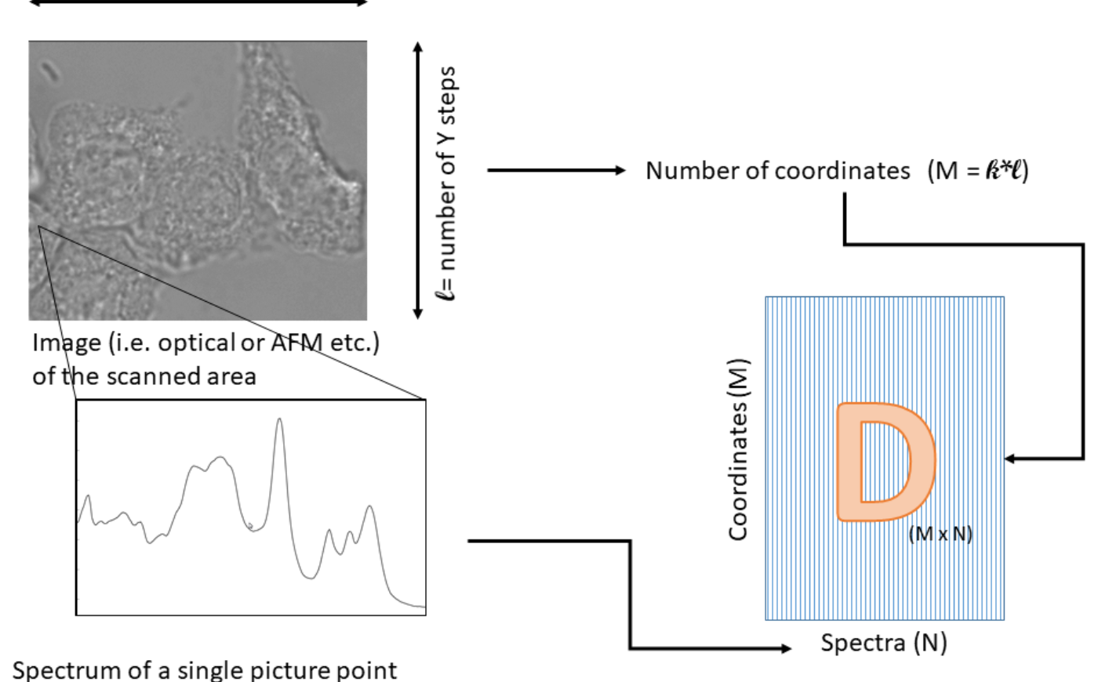
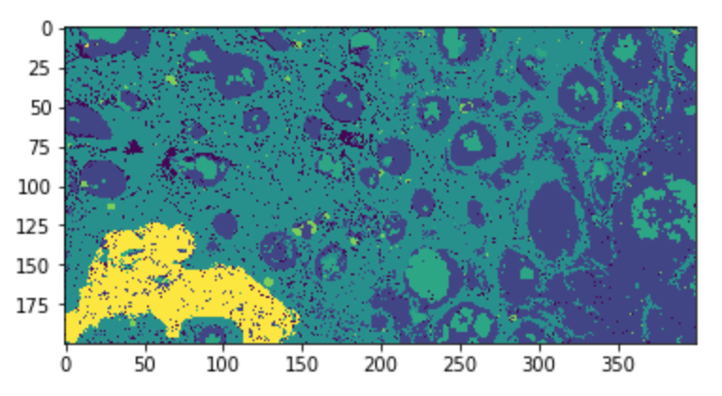
SVD decomposition
Test on t6 (400x200x1024)
D (80000x1024)

Slide 6
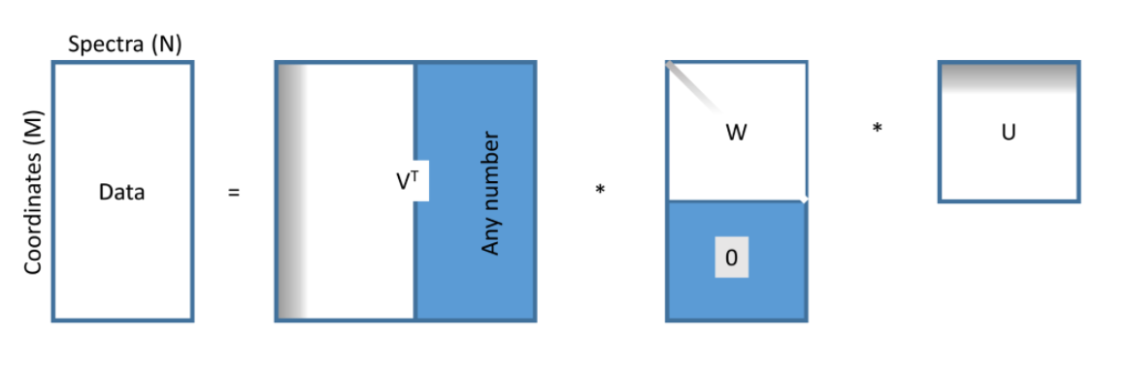
SVD decomposition

Slide 7
V (80000x1024)
Each row is a Vi vector
Each element of the vector corresponds to a coordinate
Vi depicts contribution of Ui
W (1024x1024)
Wii is the weight of the contribution
U (1024x1024)
U1 is the ‘average’ spectra
Ui are i-order deviations from average spectra

Slide 8
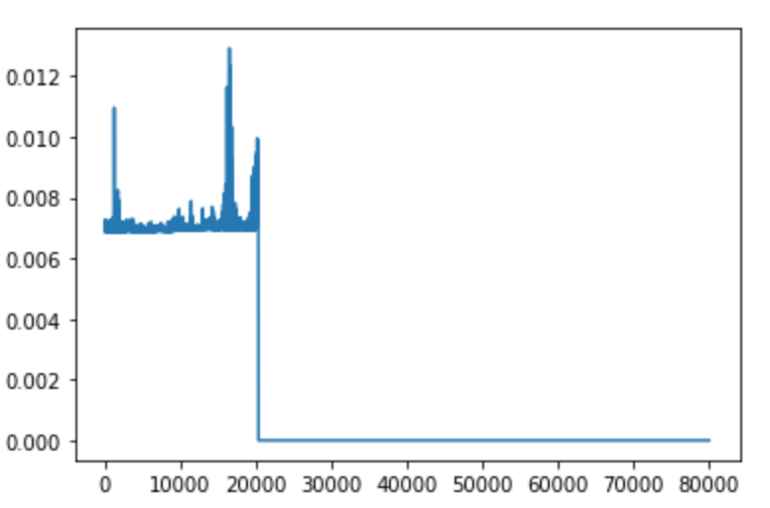
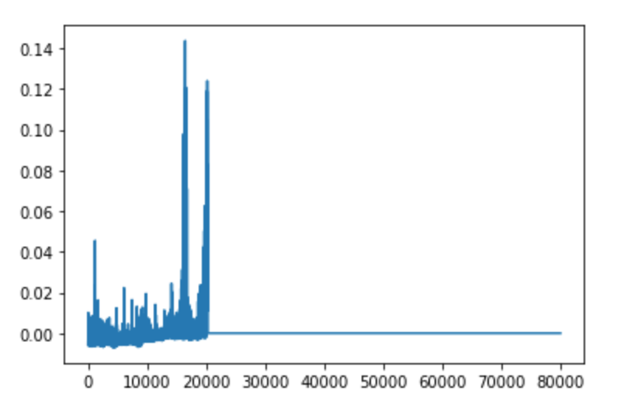
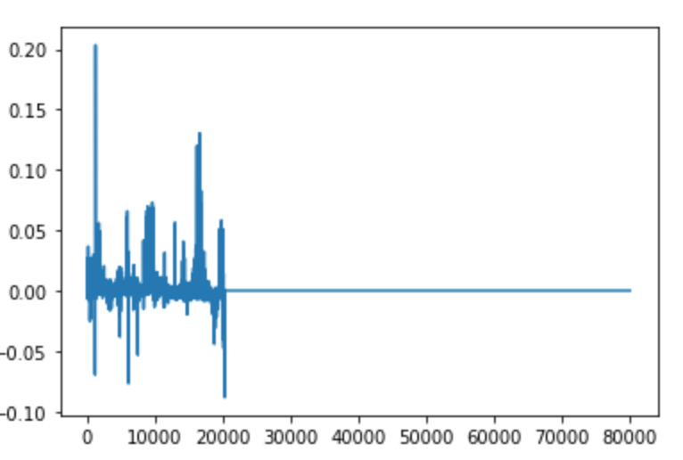
My results
V0
V1
V2

Slide 9
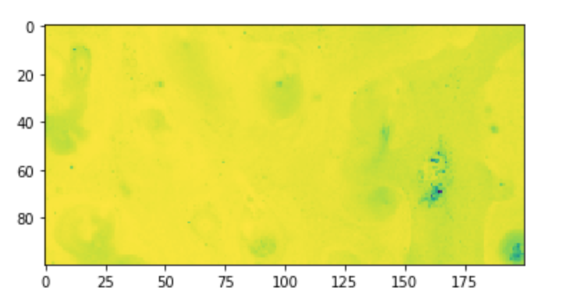
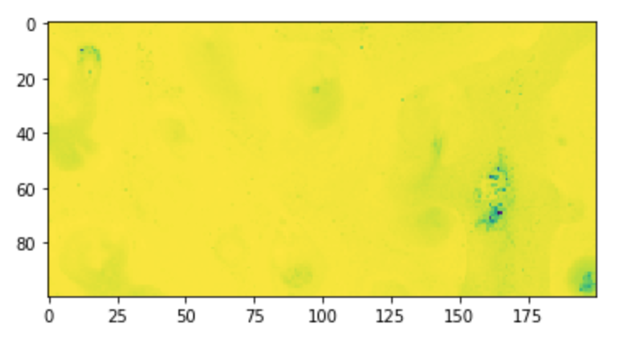
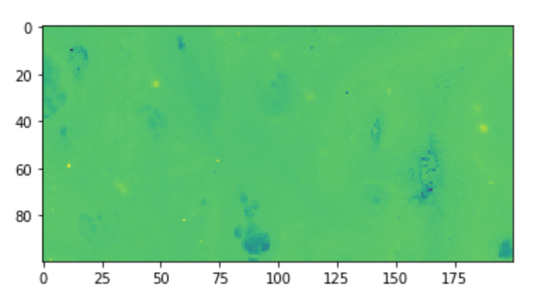
V1
V0
V2

Slide 10
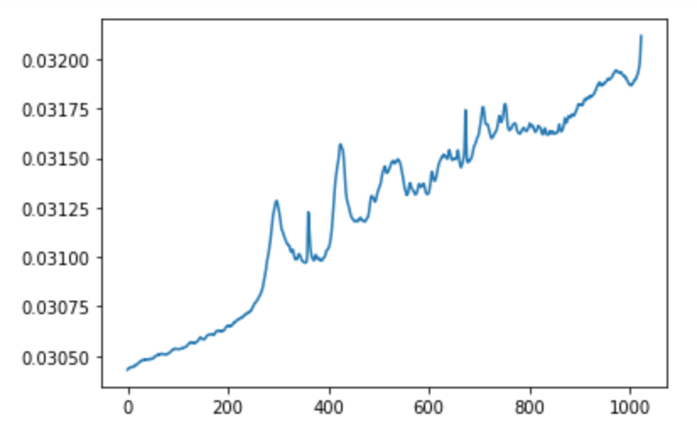
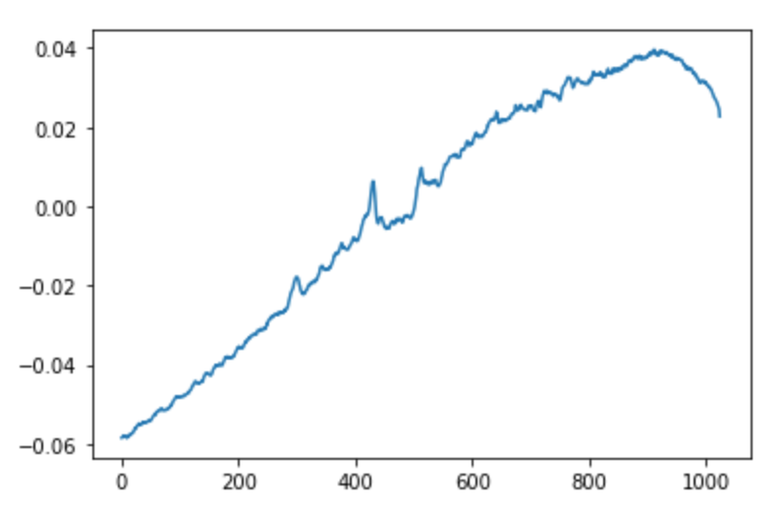
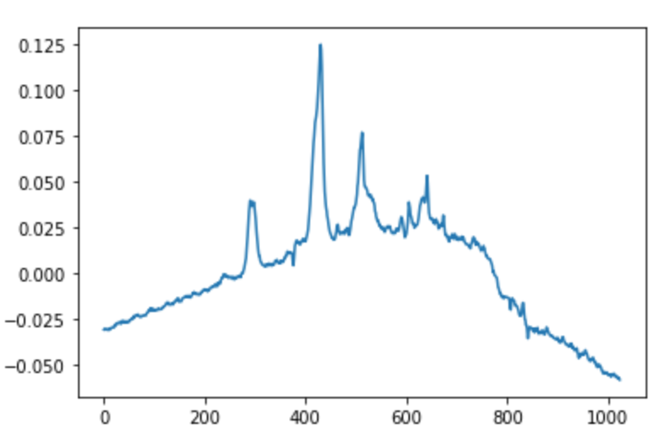
U0
U1
U2

